Slide 1
Equipment Task

Slide 2
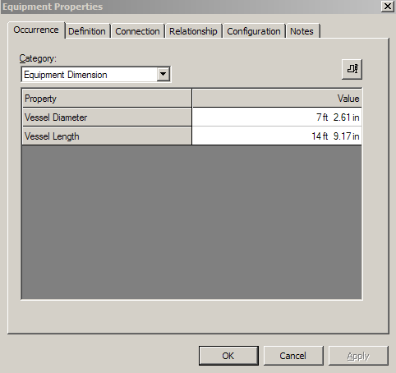
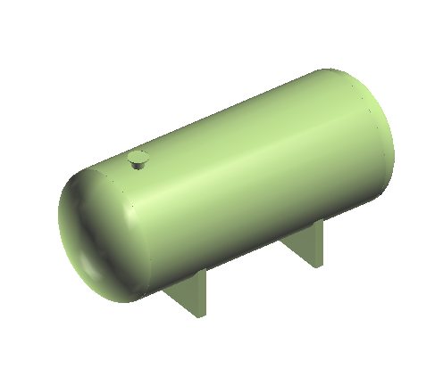
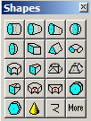
What is SmartPlant/Equipment
SmartPlant Equipment is an integrated equipment modeling environment that provides:
Parametric/Non-parametric Equipment Placement
Modeling of equipments using primitive shapes or equipment components

Slide 3
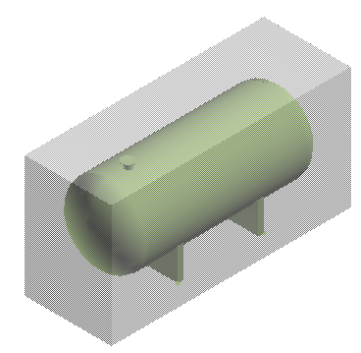
What is SmartPlant/Equipment
Equipment is a custom assembly that contains members (nozzles, shapes, equipment components, etc..)
Graphical representation of an Equipment can be created using:
  - Visual Basic (Geometry Type Functions)
  - 3rd party software – SAT format (Solid Edge v-16)
Aspects: Physical, Insulation, Maintenance, and so on …
Ports available:
  Piping port
  Ducting port
  Cabletray port
  Conduit port
  Cable port
  Foundation Port

Slide 4
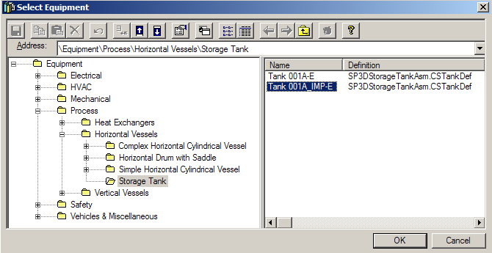
Equipment Task
Place Equipment Command
The place equipment command activates the Select Equipment dialog box (Catalog Browser) that provides access to equipment items that have been defined in the Reference Data

Slide 5
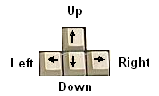
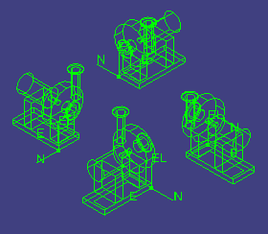
Equipment Task
Place Equipment Command
The arrow keys on the keyboard are to be used to rotate, and set the axis of rotation for any equipment object that supports a local coordinate system. These keys should work on initial placement of an object, as well as subsequent editing of objects
Up Arrow - change active axis in the recurring sequence of X, Y, Z

Slide 6
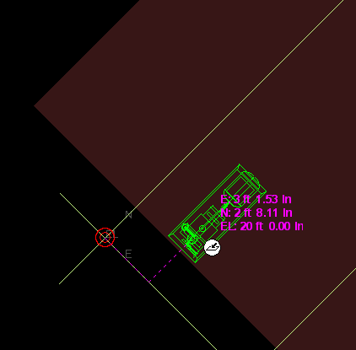
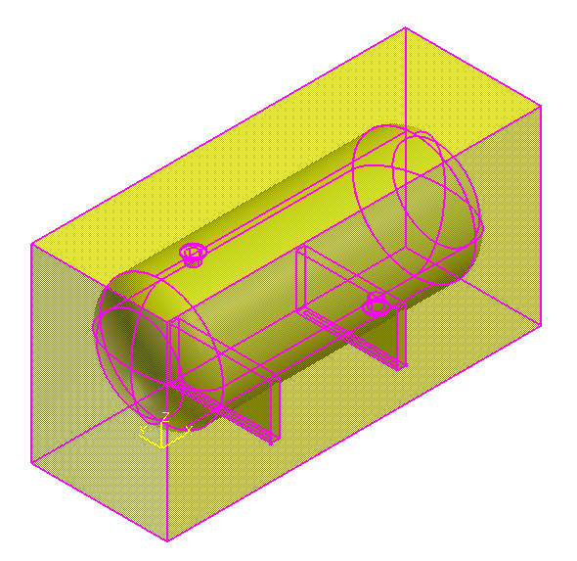
Equipment Task
Place Equipment Command
Use active coordinate system during placement
Equipment is placed using Symbol Origin by default
Rotated Coordinate System
origin

Slide 7
Equipment Task
Place Equipment SmartStep Ribbon Bar
Name
Parent System

Slide 8
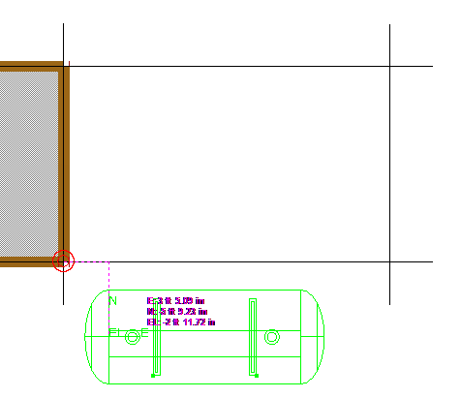
Equipment Task
PinPoint Tool
Provides coordinate inputs to the active command
x,y,z coordinates are relative to Target Point
Dynamically displays the coordinate/distance values
Lock the coordinate/distance values
Target Point

Slide 9
Equipment Task
PinPoint Tool
Use the [F] keys to lock the coordinates from the cursor’s location
Supports of mathematical operations and reference plane names
Reposition
Target
[F12]
Set Target
to the origin of the current coordinate system
Display on/off current values [F9]
Relative Tracking
Toggle between rectangular/spherical.
Step values
E lock [F6]
N lock [F7]
EL lock [F8]

Slide 10
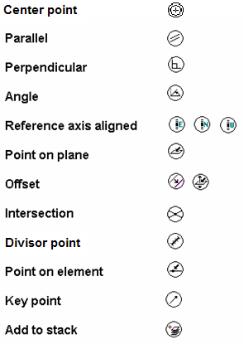
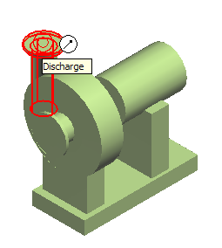
Equipment Task
SmartSketch
SmartSketch is the mechanism to automatically find special points when the command is looking for a point

Slide 11
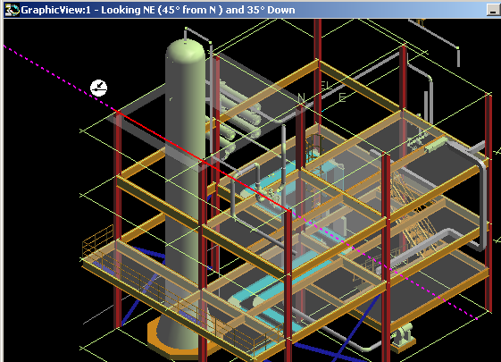
Equipment Task
SmartSketch
The system finds Key point and Point on geometry whenever you move the cursor over those points
System uses only those points (stored in the stack) and check for linear relationship points against every object in the workspace

Slide 12
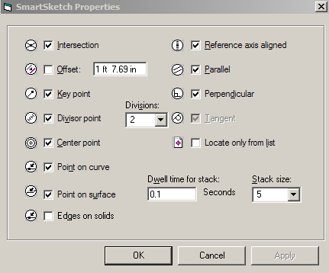
Equipment Task
SmartSketch Options
  Point on curve
  - 3D lines
  - 3D Arcs
  Point on surface
  - 3D Planes
  - 3D Projections
  - 3D Revolutions
  - 3D Cones
  - Ruled Surfaces & B-Splines

Slide 13
Equipment Task
SmartSketch
SmartSketch Lock Constraint
When SmartSketch is being used, a middle mouse click will lock the currently active smartsketch constraint
- Middle mouse button
- Ctrl –L keys

Slide 14

Equipment Task
SmartSketch
User will have two options on what objects are located by SmartSketch
- Locate on Display List
- Locate on List Only
Control –D Keys
SmartSketch Locate List Ribbon Bar
Set stack size
Clear stack
Toggle
Display/List only
Set time

Slide 15
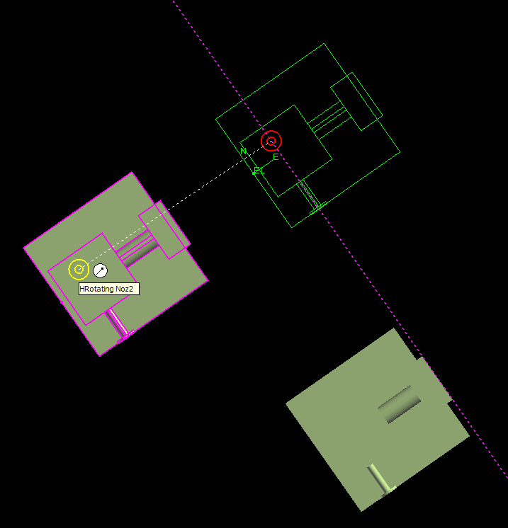
Equipment Task
Common Move command
Linear SmartSketch points are enabled in the move command. This functionality
allows easy movement along major axis/ or parallel to other objects
The origin of the item is used by default as
the Move From point
Move
To
Move
From

Slide 16
Equipment Task
Place Equipment SmartStep Ribbon Bar
Relationships/Constraints
Add constraints to further positioning the Equipment
Positioning relationships (constraints):
- Mate
- Align
- Connect
- Minimum Distance (E-W, N-S, Vertical)
- Parallel
- Mate to Tangent Plane

Slide 17
Equipment Task
Place Equipment SmartStep Ribbon Bar
Set the Positioning Relationship
Shows the last relationship added in the relationship combo box
Offset distance
Steps
Positioning Relationship
Delete Relationship

Slide 18
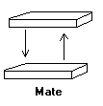
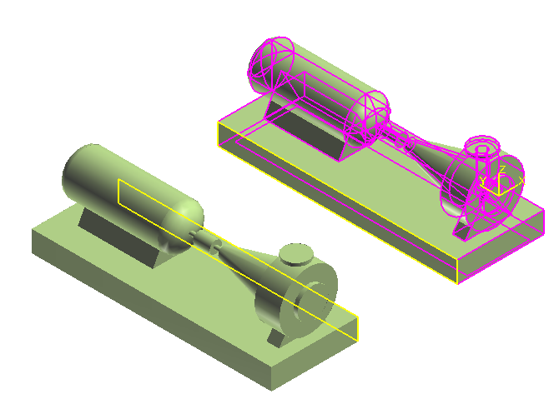
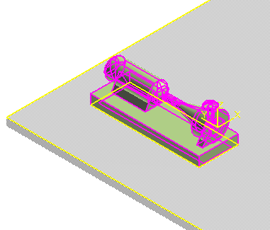
Equipment Task
Positioning Relationships
Mate Relationship
- Between planar surface and planar surface
- Surface Normal vectors point to each other

Slide 19
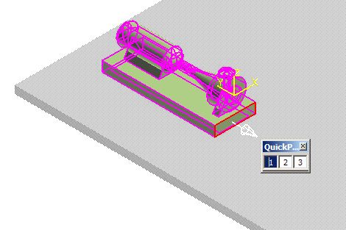
Equipment Task
Positioning Relationships
When the equipment is placed into the active workspace the default surface is automatically constraint to a surface selected in the workspace
If the equipment does not have a default surface defined, then the system uses an imaginary plane whose normal is along the local coordinate z-axis of the equipment symbol (origin)
Use Quick Pick toolbar to help you select the surface
When highlight surface for relationship, show surface direction vector

Slide 20
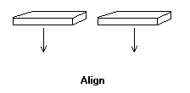
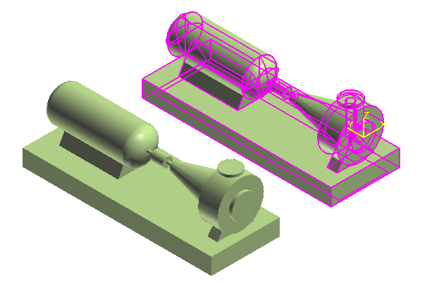
Equipment Task
Positioning Relationships
Align Relationship
- Between planar surface and planar surface
- Surface normal vectors point in the same direction

Slide 21
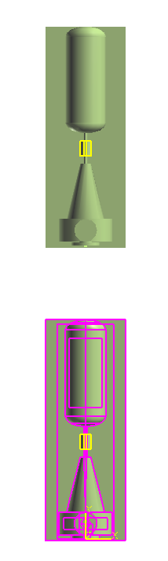
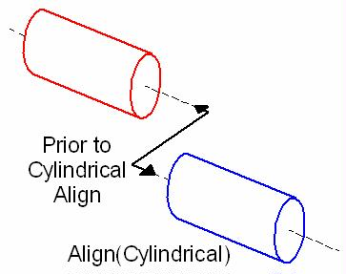
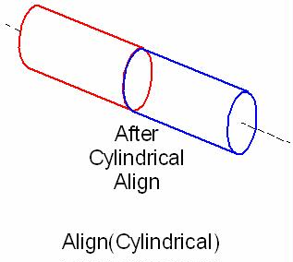
Equipment Task
Positioning Relationships
Mate/Align Relationship
- When you select cylindrical objects, the system uses the
axes to create the relationship
- Make the two axes collinear

Slide 22
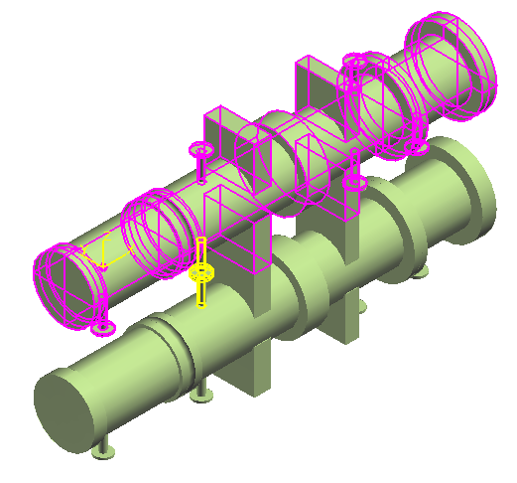
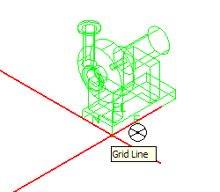
Equipment Task
Positioning Relationships
Connect Relationship
- Forces a port on an equipment to be coincident with a port on another equipment
- Implicit move command

Slide 23
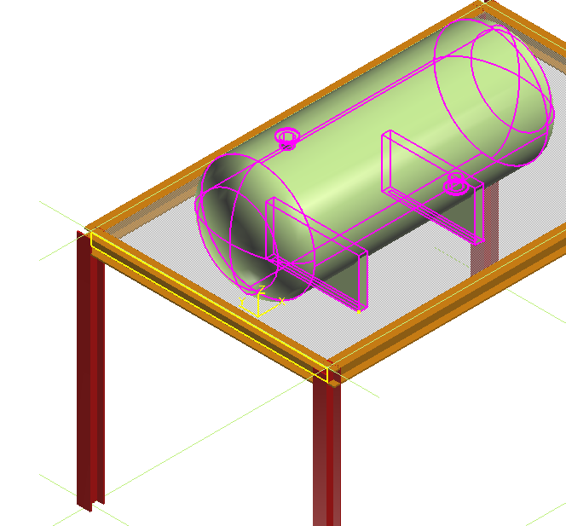
Equipment Task
Positioning Relationships
Minimum Distance Relationships (E-W, N-S, Vertical)
- Between 3D points and planar surface (example: 3D plane entities, slabs, etc)
3D Point
Surface

Slide 24
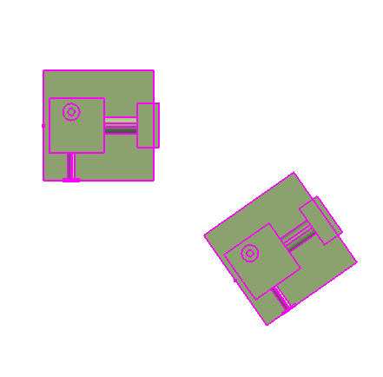
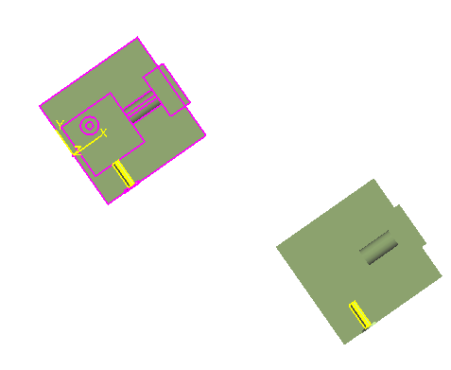
Equipment Task
Positioning Relationships
Parallel Relationship
- Only rotate the selected equipment to create the constraint
Axis
Axis
Before
After

Slide 25
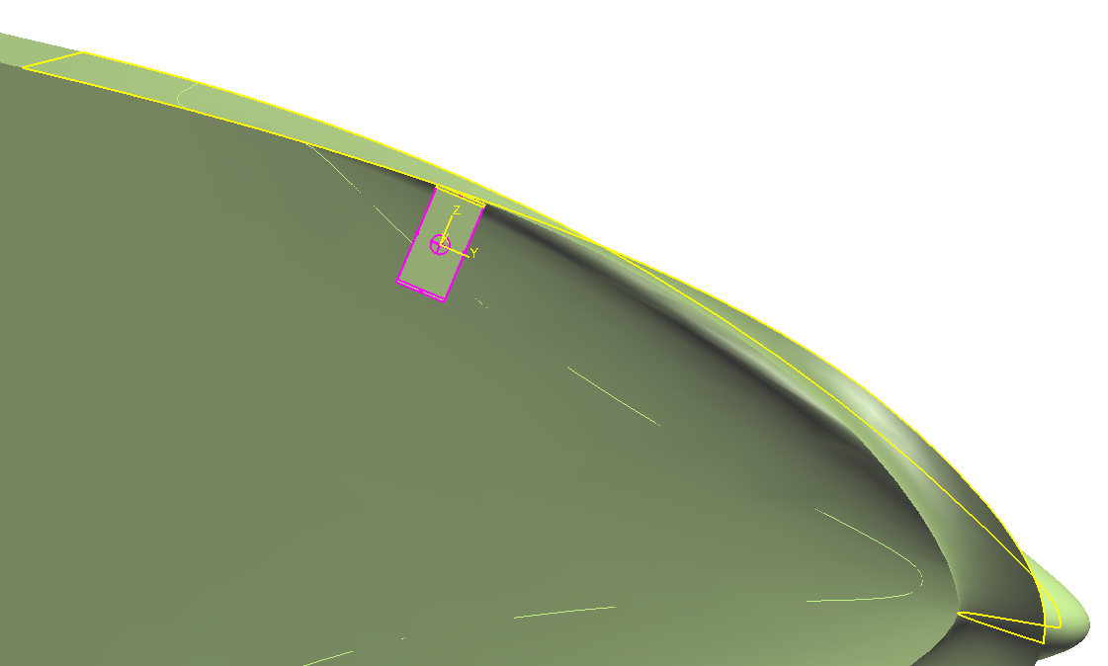
Equipment Task
Positioning Relationships
Mate to Tangent Plane Relationship
- constraint the equipment between a tangent plane created at the intersection of
a user-defined vector and a selected surface
Vector defined by two points
Mate Surface
Tangent Plane

Slide 26
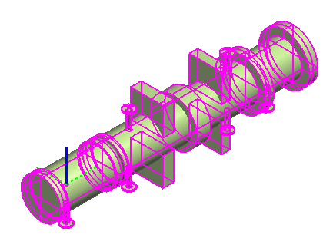
Equipment Task
Rotate Equipment
Use the Rotate Equipment Command
Use the Common Rotate Command
RotationAxis

Slide 27
Equipment Task
Rotate Equipment
Identify/Change Rotation Axis
If the Equipment is constraint, only one choice is displayed (Perpendicular to the constraint plane)
RotationAxis

Slide 28
Equipment Task
Rotate Equipment
Change the Rotation Point
The rotation point is the first foundation port of the equipment by default. If no foundation port exists, the origin of the equipment (local coordinate system origin) becomes the default point of rotation

Slide 29
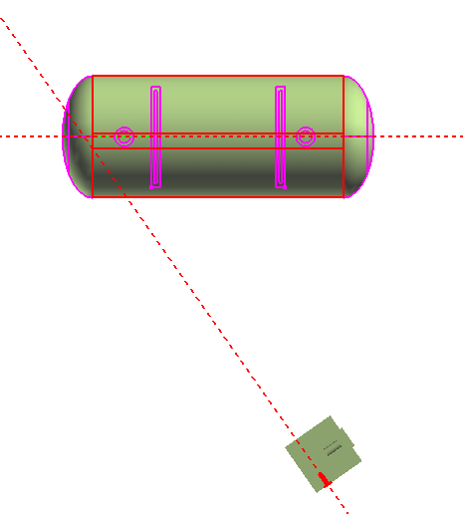
Equipment Task
Rotate Equipment
Reference on Rotation Object and Reference on Stationary Object steps
These steps allow user to define two reference lines
by selecting a surface, plane, or nozzle axis and then
system calculates the angle between these lines
3d Projection
Nozzle axis

Slide 30
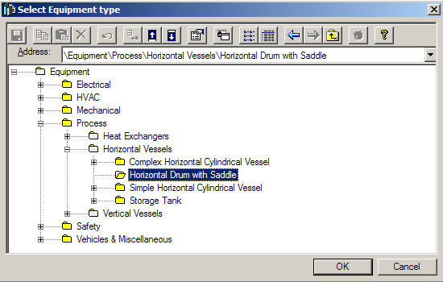
Equipment Task
Place Designed Equipment Command
The place designed equipment command activates the Select Equipment Type dialog box (Catalog Browser) that provides access to the designed equipment hierarchy

Slide 31
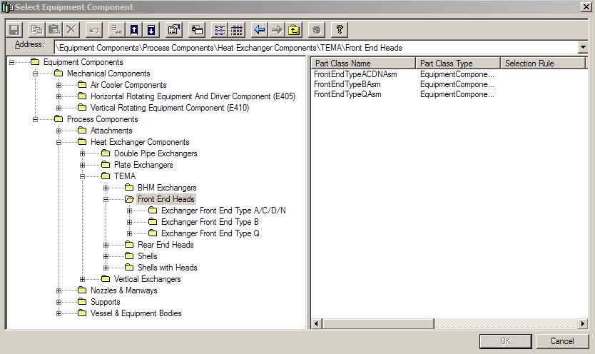
Equipment Task
Place Equipment Component Command
The place equipment component command activates the Select Equipment Component dialog box (Catalog Browser) that provides access to the equipment component hierarchy

Slide 32
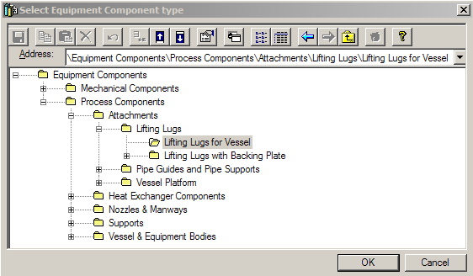
Equipment Task
Place Designed Equipment Component Command
The place designed equipment component command activates the Select Equipment Component Type dialog box (Catalog Browser) that provides access to the designed equipment component hierarchy

Slide 33
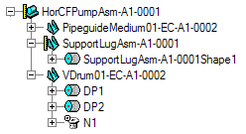
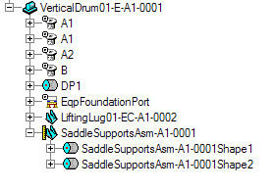
Equipment Task
Catalog Equipment vs Designed Equipment
A catalog equipment simply becomes a programmatically defined designed equipment
A catalog equipment can be designed once is placed
Designed Equipment Catalog Equipment

Slide 34
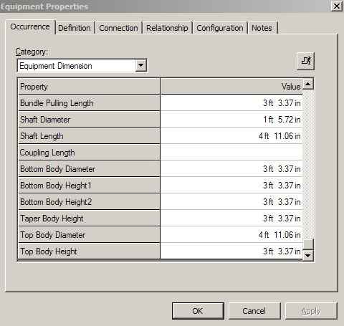
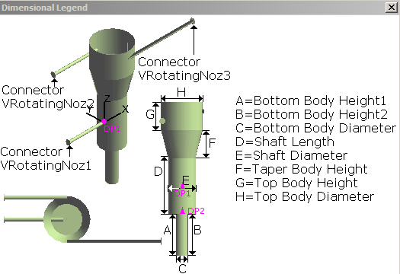
Equipment Task
Equipment Properties Page
Occurrence Tab

Slide 35
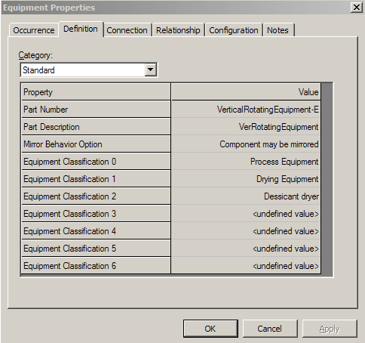
Equipment Task
Equipment Properties Page
Definition Tab

Slide 36
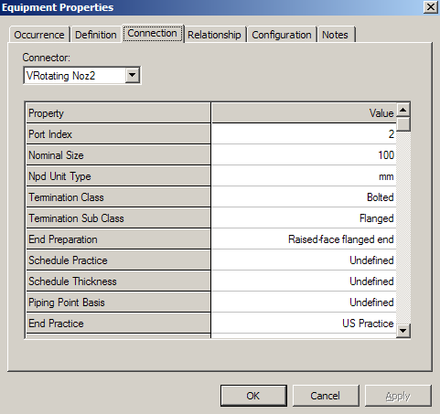
Equipment Task
Equipment Properties Page
Connection Tab

Slide 37
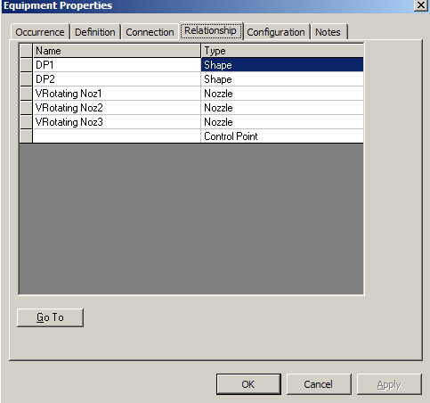
Equipment Task
Equipment Properties Page
Relationship Tab

Slide 38
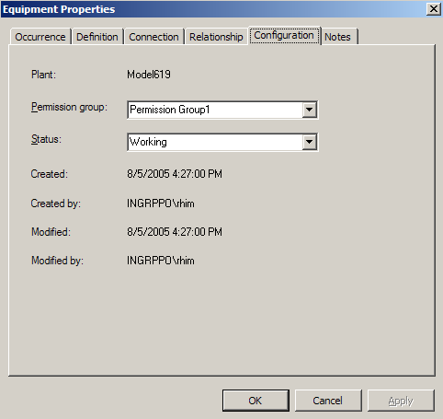
Equipment Task
Equipment Properties Page
Configuration Tab

Slide 39
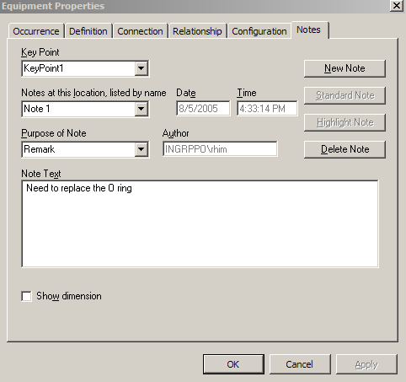
Equipment Task
Equipment Properties Page
Notes Tab

Slide 40
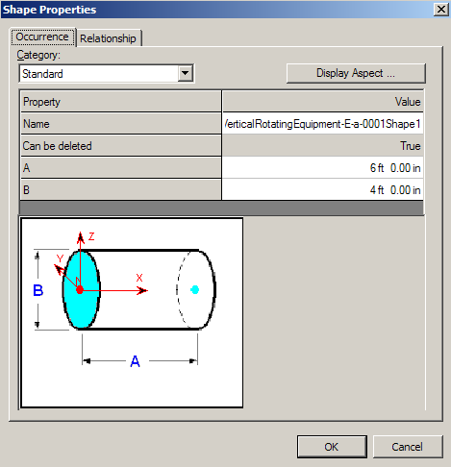

Equipment Task
Shapes
Customize palette
One-click placement
Activate Shape Reference step
Arrow keys for rotate during placement

Slide 41
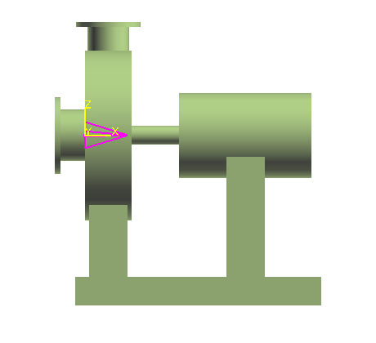

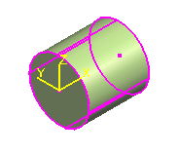
Equipment Task
Shapes
Place Shape using Symbol Origin by default
Shape (Datum Shape)
Catalog Equipments and Equipments Components come with datum shapes
Datum Shape
Origin

Slide 42
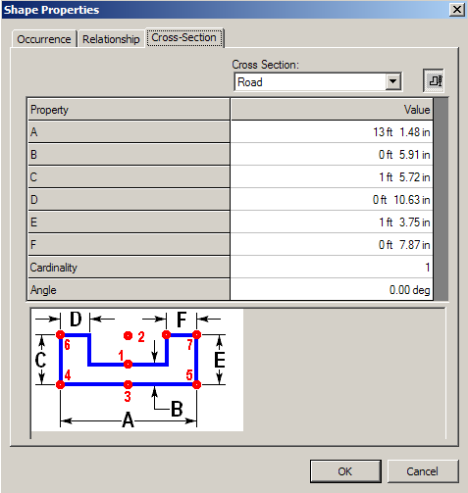
Equipment Task
Shapes
Availability of Prismatic Shapes
Prismatic Shape

Slide 43
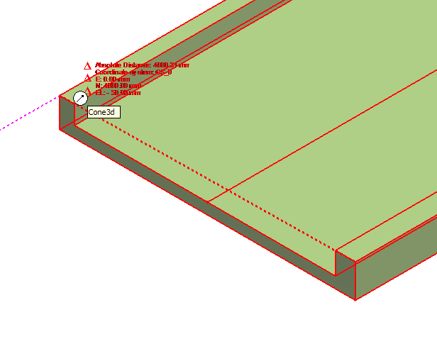
Equipment Task
Shapes
All surfaces (persisted) and edges are available on prismatic shapes
Prismatic Shape

Slide 44
Equipment Task
Place Shape SmartStep Ribbon Bar
Relationships/Constraints
Add constraints to further positioning the shape
Positioning relationships (constraints):
- Mate
- Align
- Connect

Slide 45
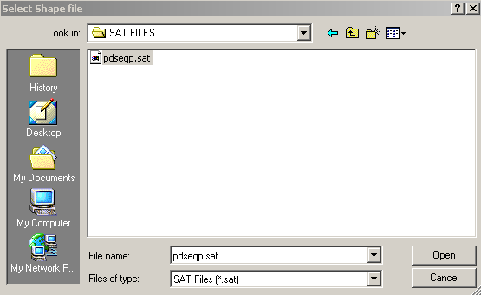
Equipment Task
Place Imported Shape from File Command
This command imports the graphics from a SAT format file as the
geometry for a shape
ACIS Output File Format
The geometry will be converted to G-type format in the model
The shape’s origin is defined by the coordinate system of the SAT file

Slide 46

Equipment Task
Place Nozzle Command
All nozzles become First Class Business Object with their own
identity. They are not nested outputs of the symbol
Support occurrence properties for nozzles in catalog equipment
Positioning relative to Equipment, Equipment Component and Shapes
Ports are displayed in Workspace Explorer

Slide 47


Equipment Task
Place Nozzle Command
Provide predefined nozzles (values) in catalog for placement

Slide 48

Equipment Task
Place Nozzle Command
Port Type:
Piping Straight Nozzle
Piping Elbow Nozzle
Conduit port
Cabletray port
Cable port
Hvac port
Foundation port
Pipe Port (No Added Graphic)
Hvac Port (No Added Graphic)

Slide 49

Equipment Task
Place Nozzle Command
Placement Type:
Radial
Axial
Tangential
Skew
Offset Skew
Position by Plane and Axis
Position by Point

Slide 50



Equipment Task
Position and orientation properties
Equipment, Shape and Nozzle
Bearing readout from ACS North

Slide 51
Equipment Task
Replace Equipment Command
Exchanges a selected equipment or equipment component in the model for a different item from the catalog
System keeps the position and orientation properties the same

Slide 52
Manipulation Commands
Equipment Task
  Equipment Entities Manipulation
  - Select Command
  - Delete Command
  - Undo Command
  - Move Command
  - Rotate Command
  - Open the properties page
  - Copy/Paste Command
  - Mirror Copy command
  - Paste and Restore command

Slide 53
Equipment Task
Summary - Modeling
Catalog Equipments and Designed Equipments have the same structure and the same persistence
Catalog Equipments can have optional members (managed by the CAD API)
Catalog Equipments can have interactively added shapes, nozzles, Equipment components etc… just like Designed Equipments
Designed Equipments have a symbol reduced to a single control point. Their parts are defined in the model
Designed Equipments require a placement point at creation time
Nozzles are filterable (but show/hide and style rules are not applicable)

Slide 54
Equipment Task
Summary - Modeling
Equipment Components follow the same logic as Equipments
Equipment Components cannot be placed standalone, they must have an Equipment as parent
Equipment Components are Assemblies
Equipment Components cannot have children Equipment Components
Equipments cannot have children Equipments
Constraint system works on homogeneous object types:
  Equipment to Equipment
  Shape to Shape (for siblings of an Equipment or Equipment component)
  Equipment Component to Equipment Component (for siblings of an Equipment)

